Slide 1
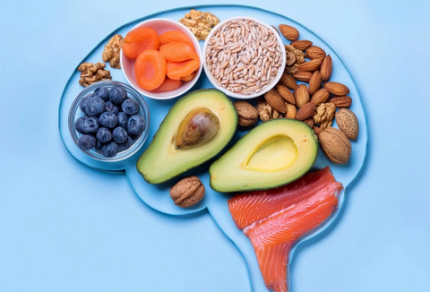
Foods that can improve Brain function
Topic: Nutrition and cognitive function

Slide 2
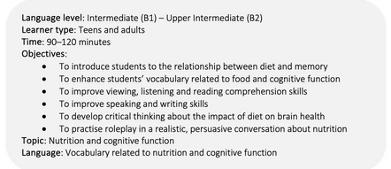

Slide 3
Students
learn vocabulary related to nutrition and cognitive function,
discuss quotations about food, talk about nutrition and cognitive function,
predict the content and watch a short video (comprehension questions)
write about what they have learned from viewing a short video,
develop critical thinking skills by exploring issues raised in a short video,
read an article, answer comprehension questions, discuss topics raised in an article,
perform a roleplay,
and reflect on the lesson.

Slide 4

”Tell me what you eat, and will tell you who you are.”
To zdjęcie, autor: Nieznany autor, licencja: CC BY-SA

Slide 5
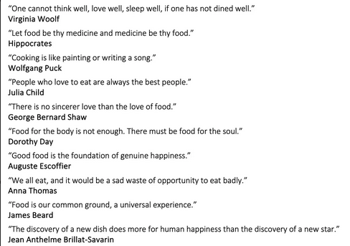

Slide 6

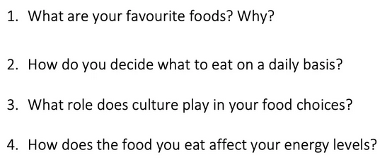
Pre-viewing questions

Slide 7
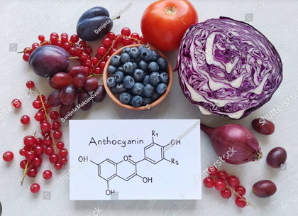
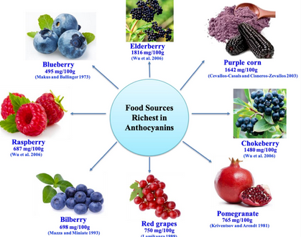
anthocyanins

Slide 8
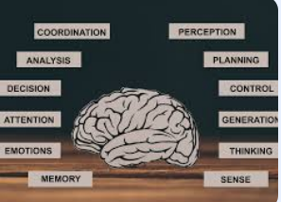
COGNITIVE
Adj. relating to mental processes such as
thinking and memory

Slide 9
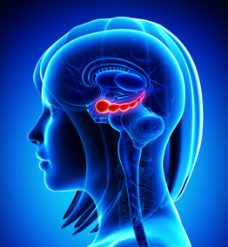
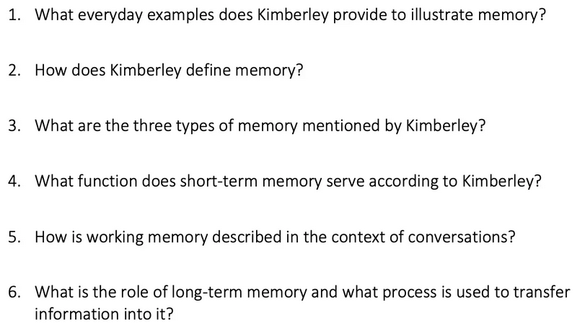
Viewing questions

Slide 10
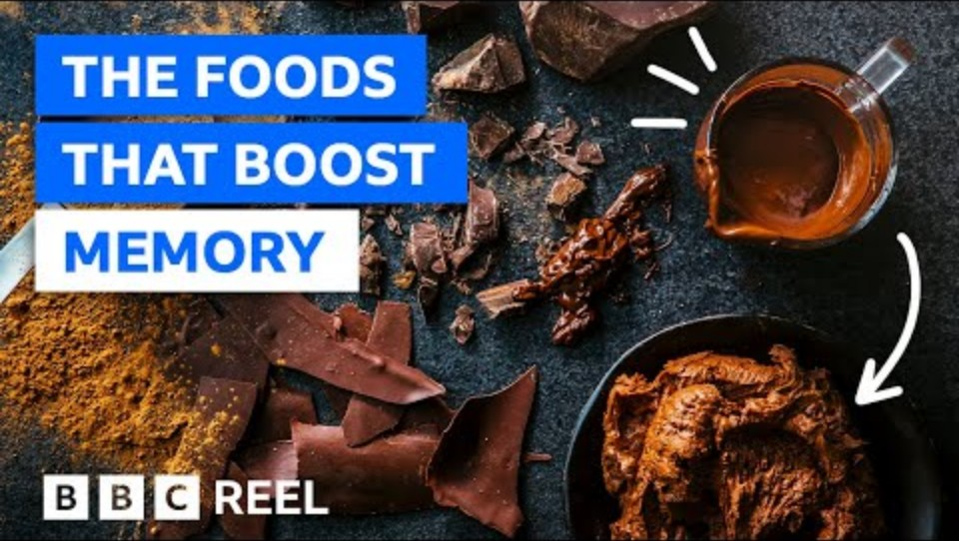

Slide 11
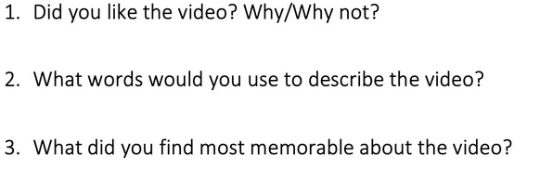
POST-VIEWING QUESTIONS

Slide 12
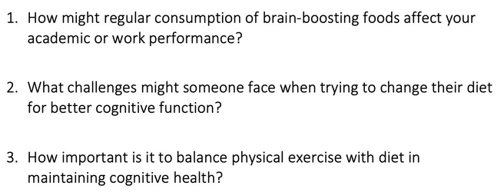
CRITICAL THINKING

Slide 13
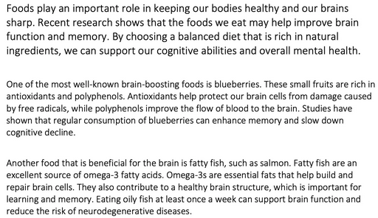
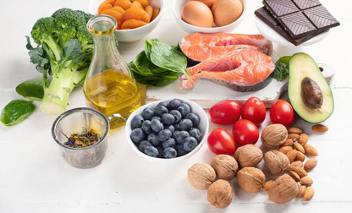
READ ARTICLE

Slide 14
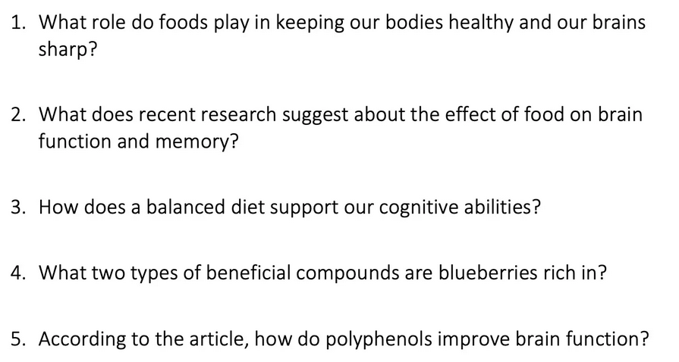
COMPREHENSION QUESTIONS

Slide 15
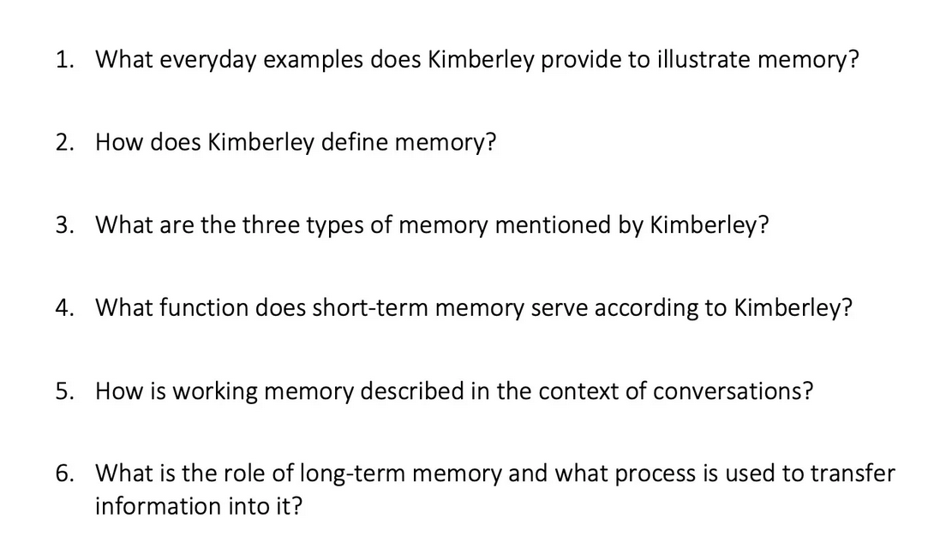

Slide 16

ROLE-PLAY

Slide 17
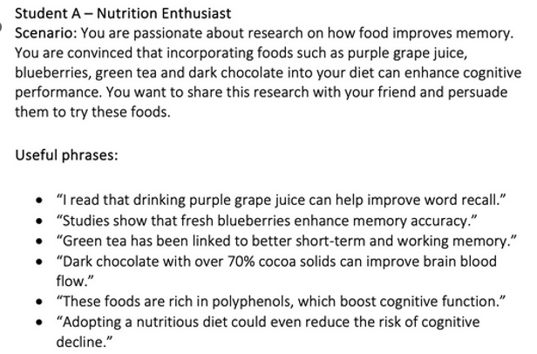

Slide 18
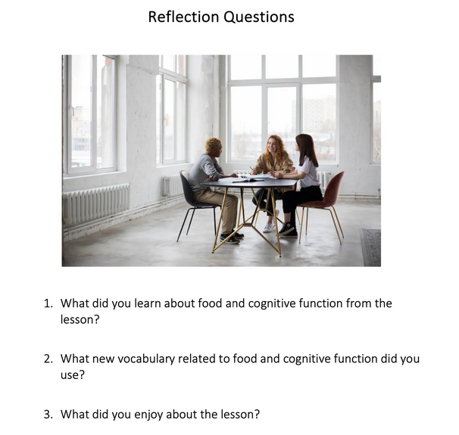

Slide 19
