Slide 1


Slide 2
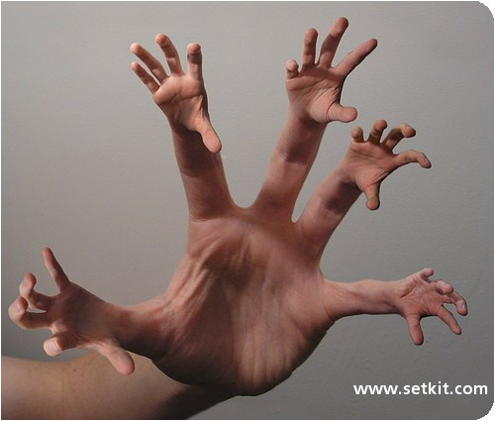

Slide 3

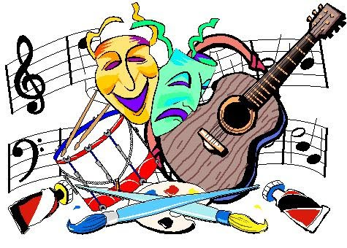
Which areas of culture are you most interested in?
THE ARTS

Slide 4


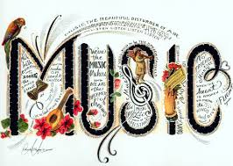


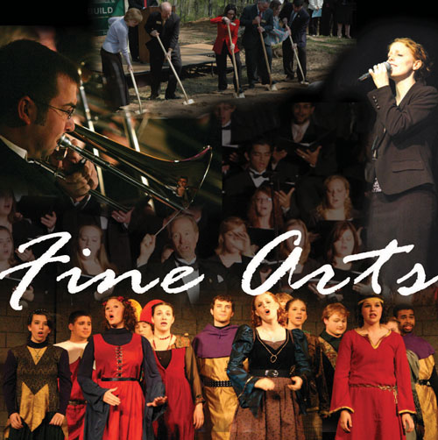


Slide 5


Slide 6
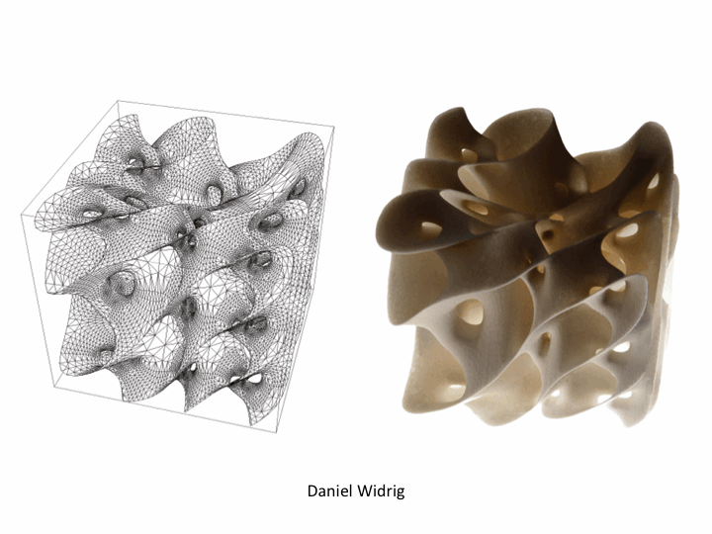
New media art
artworks created with new media technologies, including
digital art,
computer graphics,
computer animation,
Internet art,
interactive art,
video games, computer robotics,
and art as biotechnology.

Slide 7


Slide 8
Artists / Performers
Painter
Photographer
Sculptor
Painter
………………………………………..

Slide 9
Artists / Performers
Composer
A lead singer
A conductor
Songwriter
A busker
An orchestra
A choir
A folk group
An opera
A string quartet

Slide 10
Forms of writing
Guess who does this form of writing -person?
Book review literary critic
Newspaper article j_ _ _ _ _ _ _ _
Novel _ _ _ _ _ _ _ _
Play p_ _ _ _ _ _ _ _ _
Poetry p_ _ _
Screenplay/script _ _ _ _ _ _ _ _ _ _ _ _
Song _ _ _ _ _ _ _ _ _ _

Slide 11
Types of books
Autobiography
Science fiction
Fantasy
Crime strory
Travel guides
Classic novels
Encyclopedia
Ghost story
Fairy tales

Slide 12
A part of the whole
An act in aplay
A chapter in a book
An episode of a series
A scene in a film/ poem/ a play
A track on an album
A verse in a film/ a song/ a poem

Slide 13
6 cultural things to do before you’re 18
See a live band
Visit a big art gallery
Go to an art exhibition
Listen to a Beethoven symphony
Act in a play
Read a classic novel
Write a poem or a short story
-Have you seen a live band yet? (I’ve already seen…/ I haven’t seen yet…)
-Who did you see? What were they like?

Slide 14
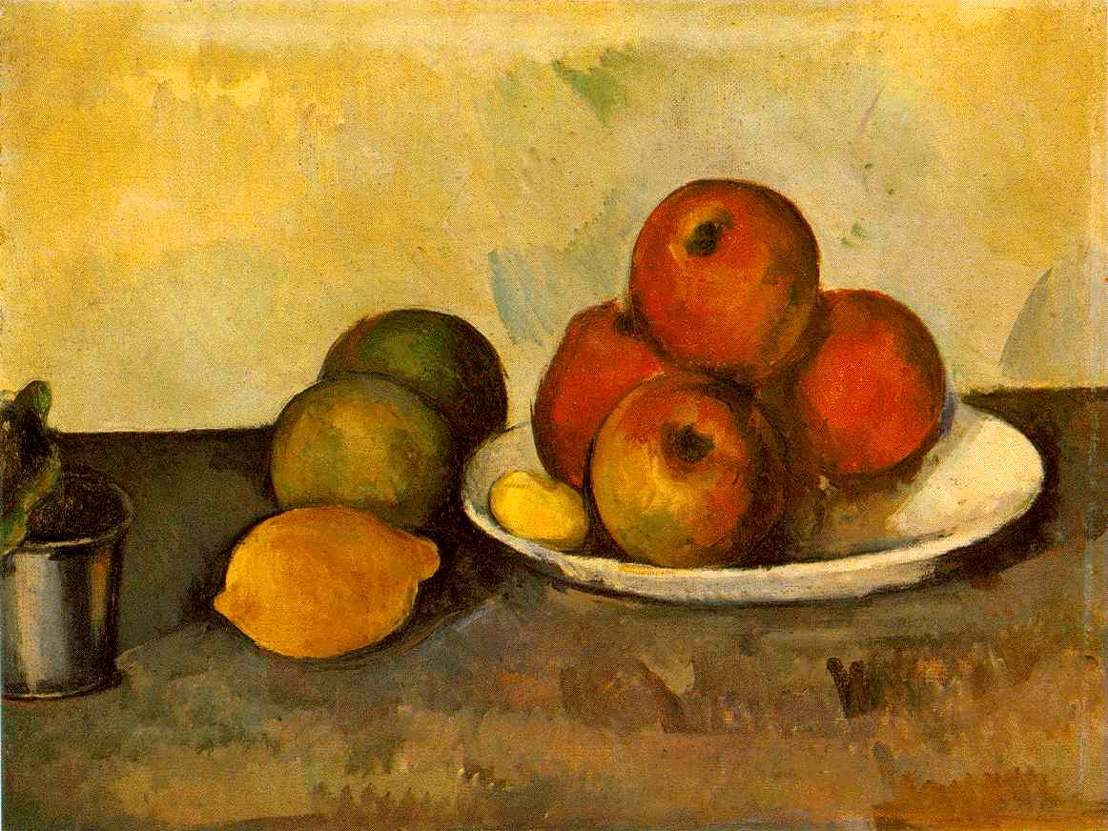
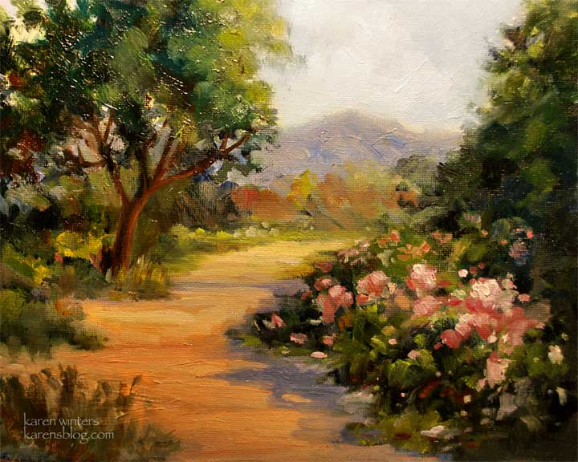
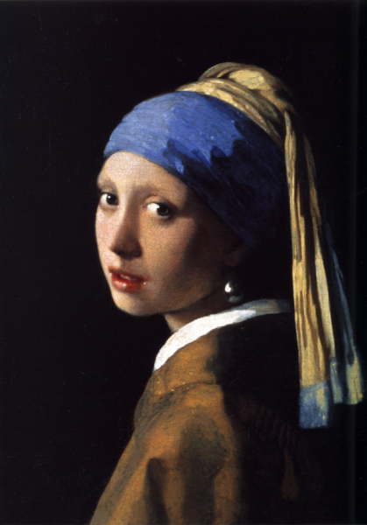
Works of arts
Paintings
Portrait
Landscapes
Still life

Slide 15
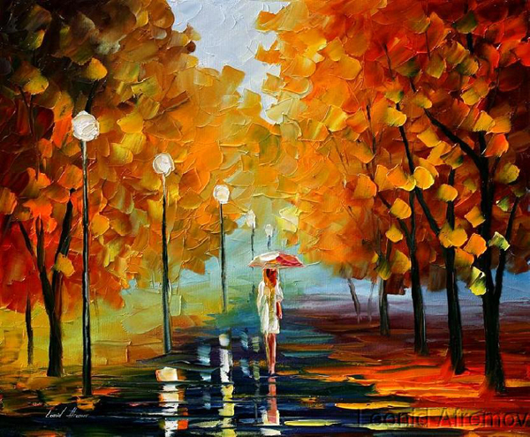
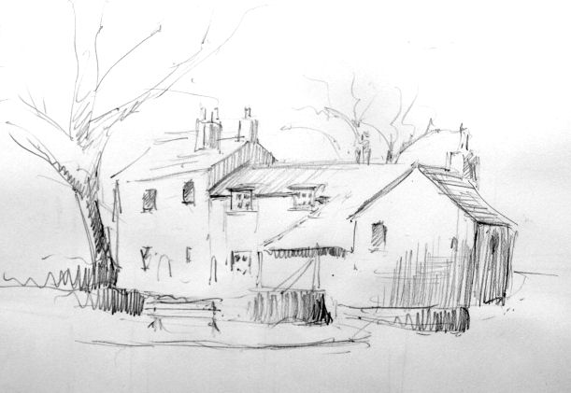
Drawing
Collage
Oil painting
MASTERPIECE
PIECE OF ART

Slide 16
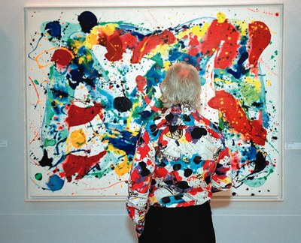
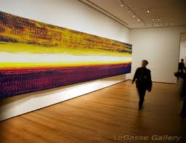
Abstract art

Slide 17
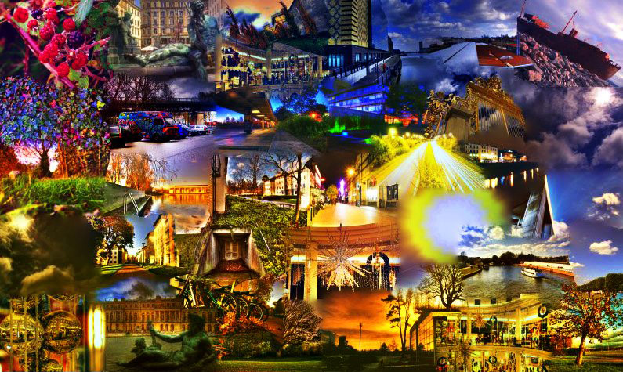
Collage

Slide 18
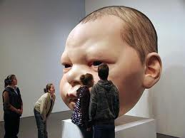
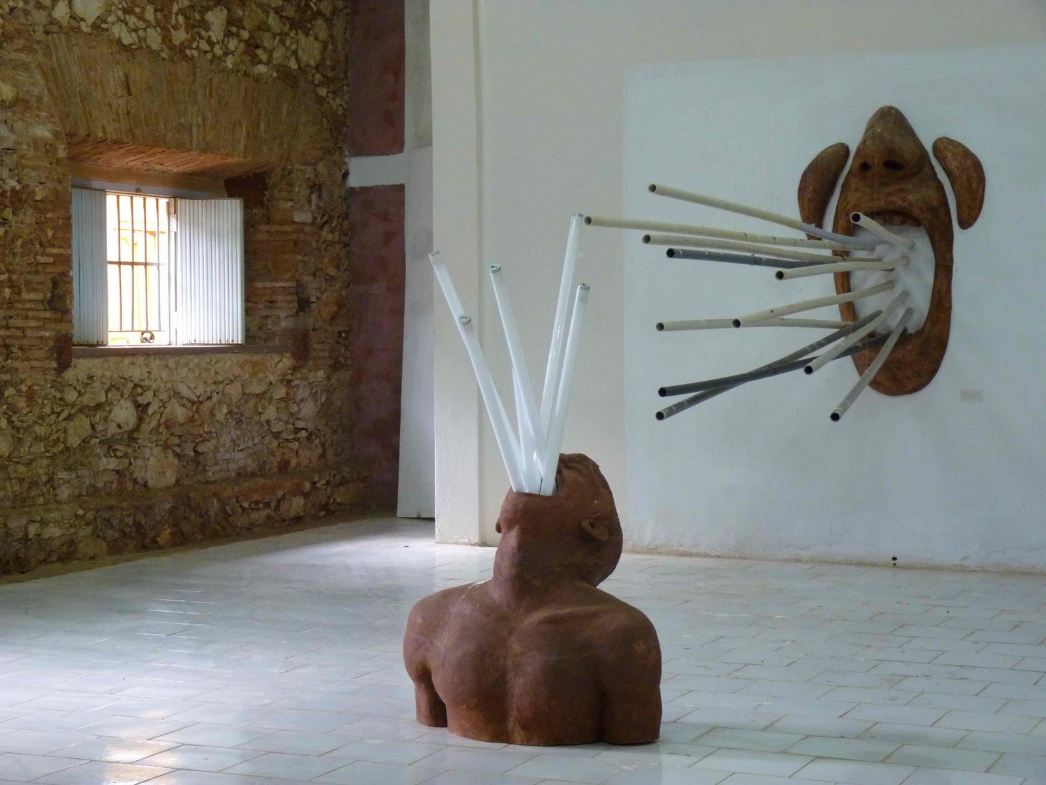
Sculpture

Slide 19
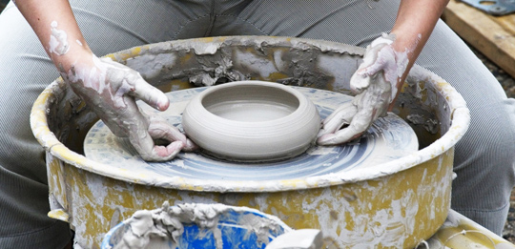
Pottery

Slide 20
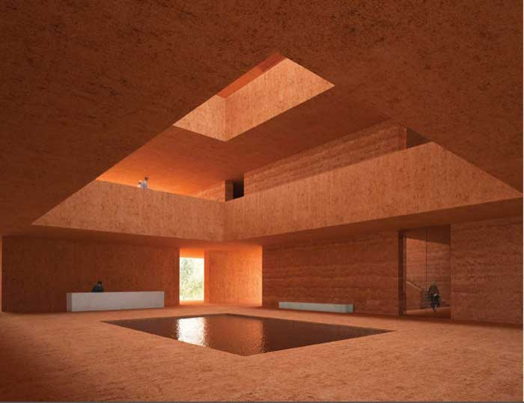
Visual arts

Slide 21
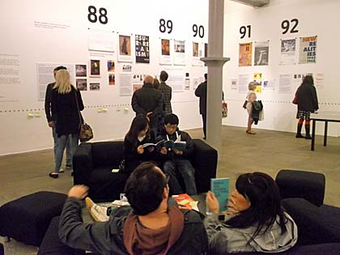
Describe the picture

Slide 22
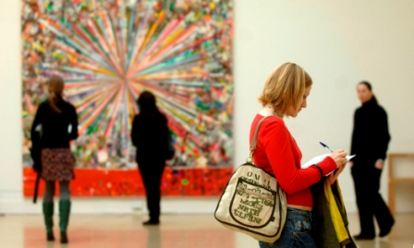

Slide 23
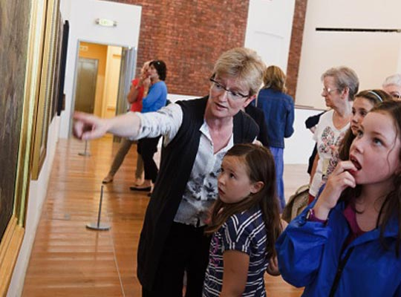
Describe

Slide 24
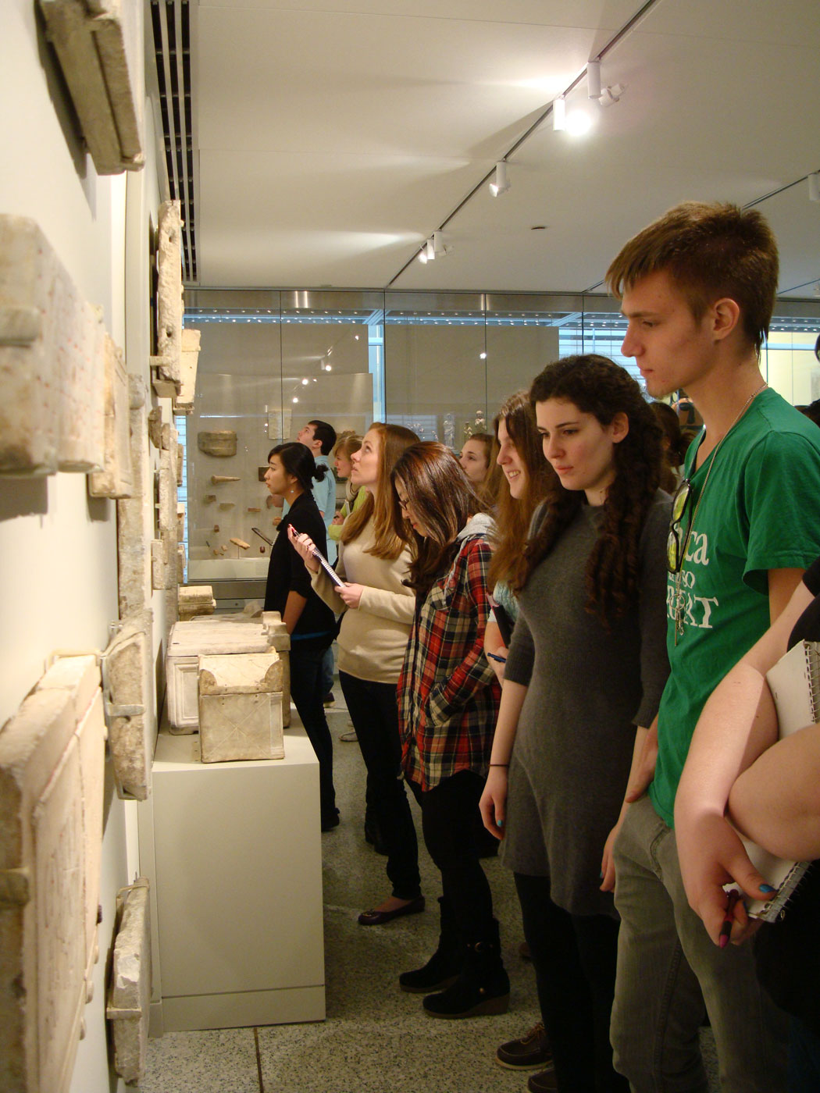
Art exhibition
exhibits
artworks- art objects
artefacs-objects
visitors, audience
exhibition / show
exposition presents….
a display of a few exhibits

Slide 25
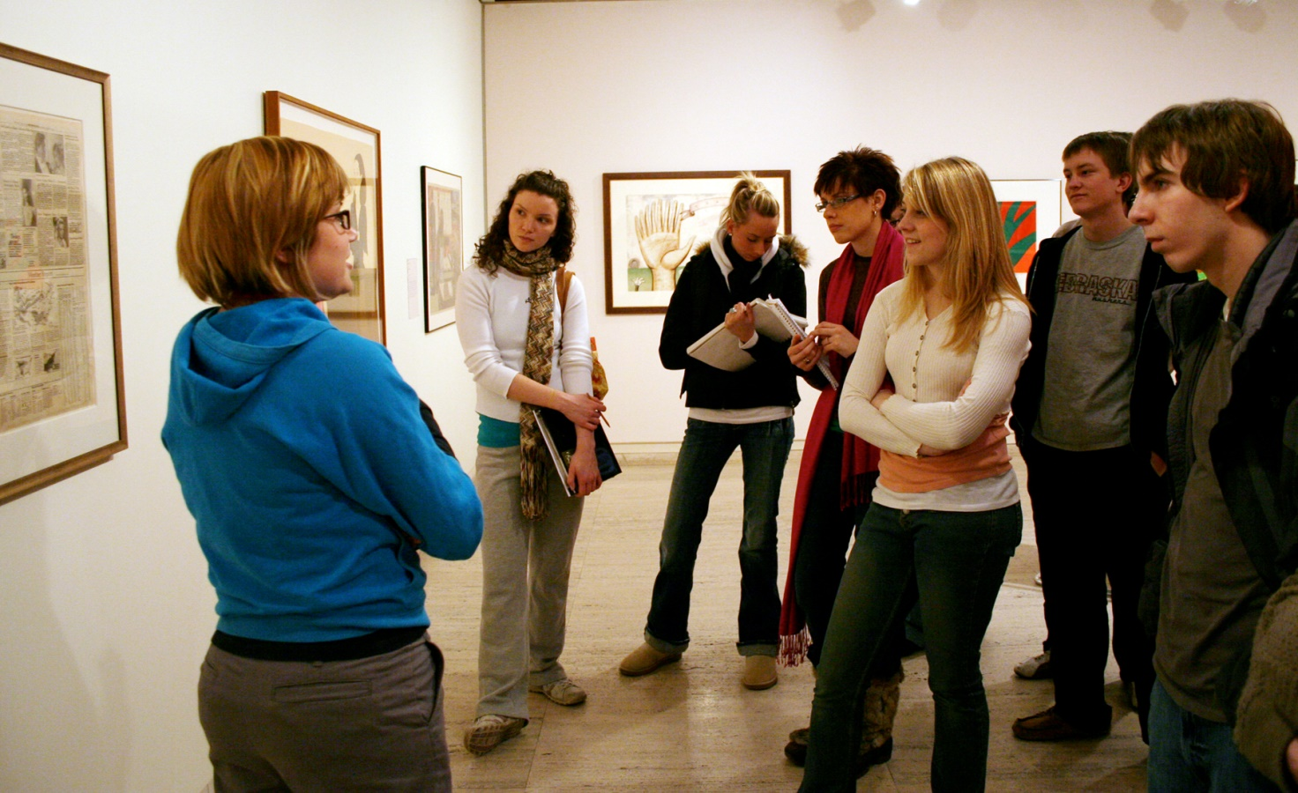

Slide 26
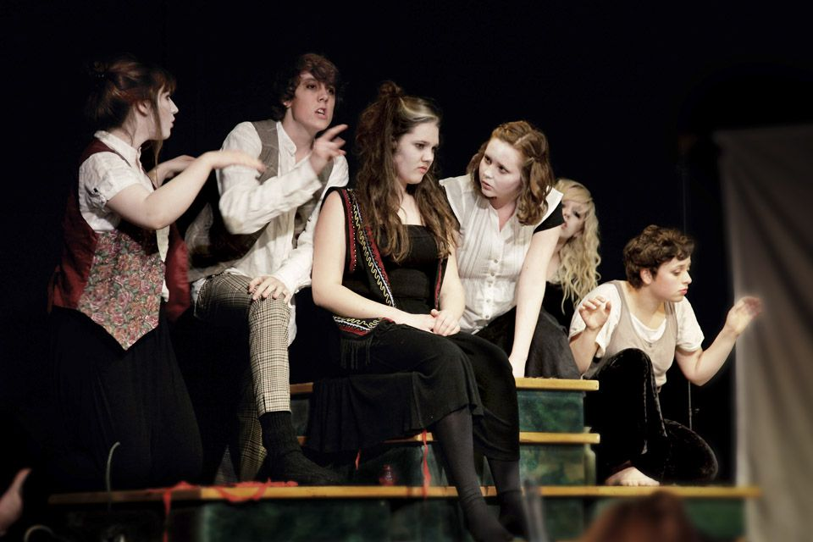
Describe the picture

Slide 27
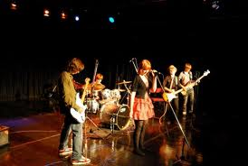

Slide 28
A book
Finding out about a book
• Who wrote the book?
• What can you find out about the author, e.g. country, first language, age, experience, qualifications?
• Why did the writer write this book?
• What interest does the author have in the topic?
• Who published the book, where and when?
• Do your answers to the questions so far make a difference to how you feel about the information, ideas and opinions in the book?
• Who and what does the introduction say the book is for?
• What are the main text divisions?
• Is there a good contents page/system of subheadings/index so that you can find things easily?
Read the first line/paragraph/chapter or the introduction and the last line/ paragraph/chapter or the conclusion.
• What can this book help you with?
• What can this book NOT help you with?
• Does the author recommend other sources of information?
• What questions would you like, or do you need, to ask to learn from this book?

Slide 29
A poem
I love it when …
I love it when people smile at me.
I love it when music starts to play.
I love it when dinner is ready.
I love it when there is a sunny spot in the garden.
I love it then. I love it then.

Slide 30
A festival
Ideas for questions to ask about a festival:
• How do people prepare for the festival?
• Do people eat special food or wear special clothes?
• Is there any music?
• What happens?
• Is it dangerous in any way?
• What is the high point?
• How long has the festival existed?
• What does it mean?
• What is it for?
• Who is it for?
• How many people go?
• Are there any special objects or animals involved?

Slide 31
Gość z Anglii pyta Cię o ciekawe wydarzenie kulturalne w Twoim mieście…..
Poleć jedno wydarzenie warte obejrzenia
Wyjaśnij, na czym polega jego atrakcyjność
Udziel informacji na temat jednego z artystów
Udziel informacji na temat rezerwacji biletów
Poinformuj jak dojedziecie na miejsce

Slide 32
Describe a cultural event
Very unusual – extra_ _ _ _ _ _ _ _
Quite unique - unfor_ _ _ _ _ _ _
Very lively and cheerful.

Slide 33


Slide 34
TALKING ABOUT FILMS
YouTube link

Slide 35
Watch FILMS / MOVIES
Go to the cinema / Go to the movies

Slide 36
Film TYPES / GENRES
genre (noun) – a stylistic category of literature, film or
other artworks

Slide 37
http://youtu.be/Gb87bAkFkYc GENRES

Slide 38
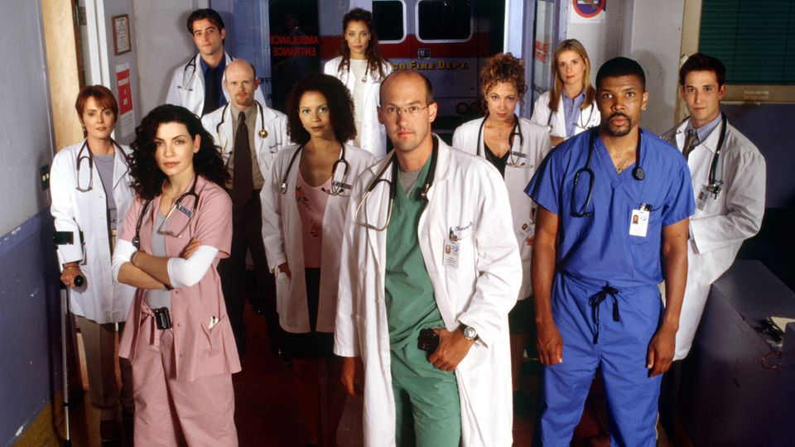
_ _ _ _ _ _ _ _ drama (TV series)
a medical drama.
Episodes are set in hospitals but also show personal lives.

Slide 39
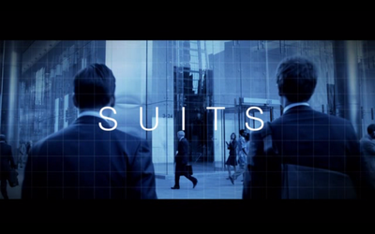
Legal drama

Slide 40
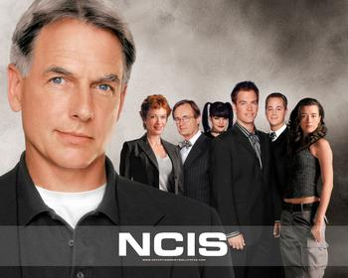
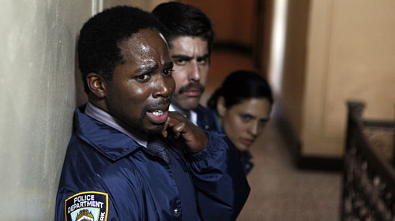
_ _ _ _ _ _ - drama (TV series)
a story or drama about the investigation of a crime by the police

Slide 41
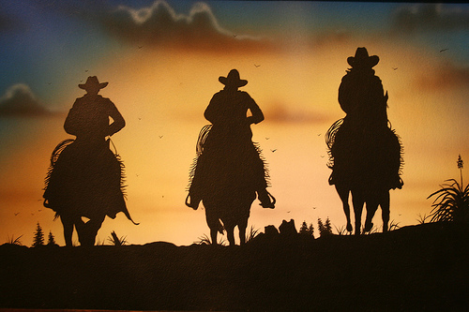
W_ _ _ _ _ _
telling stories about cowboys,
set in the later half of the 19th century in the American Old West

Slide 42
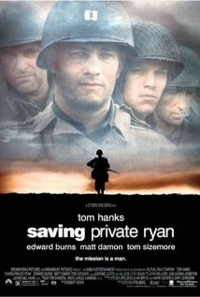
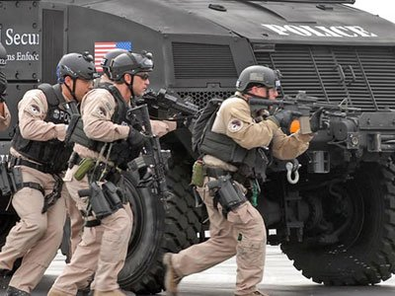
W_ _ film
about battles, prisoners of war, military operations or daily life in wartime

Slide 43
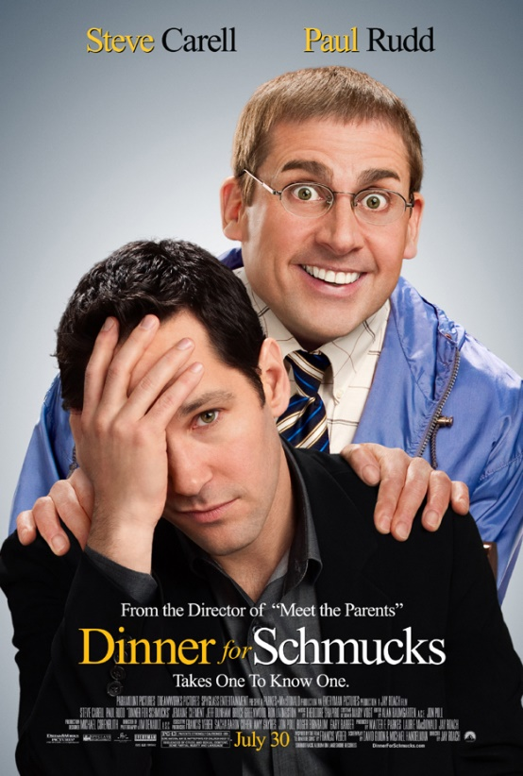
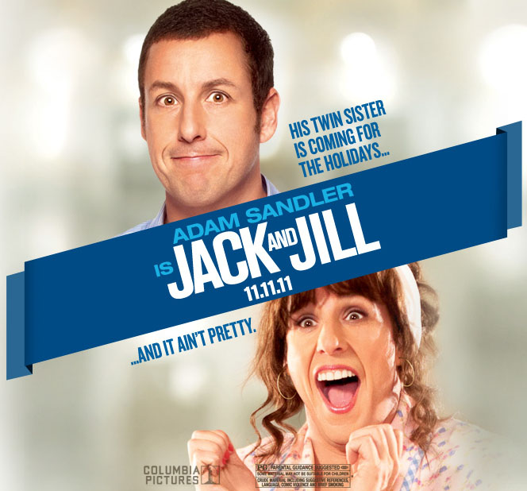
C _ _ _ _ _
funny with lots of jokes…it makes you laugh…hilarious

Slide 44
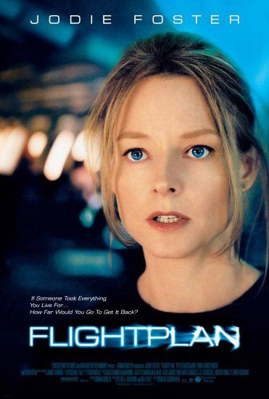
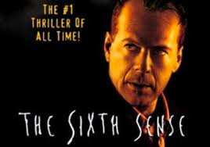
Th_ _ _ _ _ / Mystery / Suspense
Psychological thriller, suspense, drama.
Action, drama – genres overlap!
sometimes intense, not light or relaxing…

Slide 45
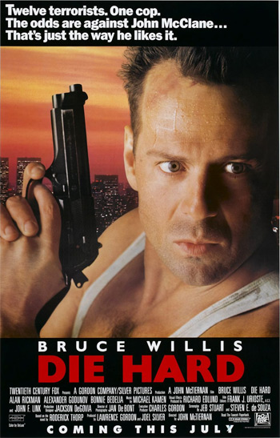
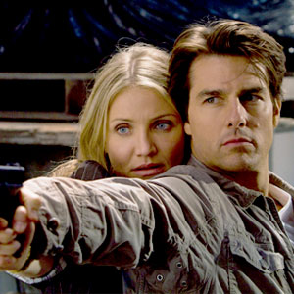
A_ _ _ _ _ film
have exciting car chases and fights, gunfights, exploding cars…

Slide 46
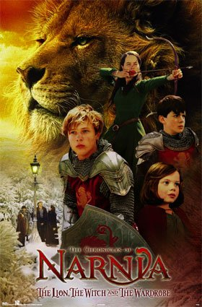
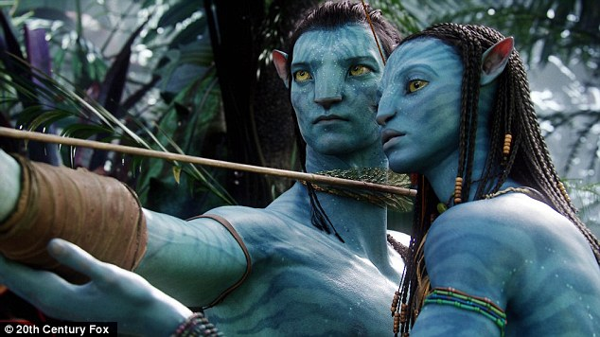
F_ _ _ _ _ _
about magic, supernatural events, make-believe creatures, or exotic fantasy worlds

Slide 47
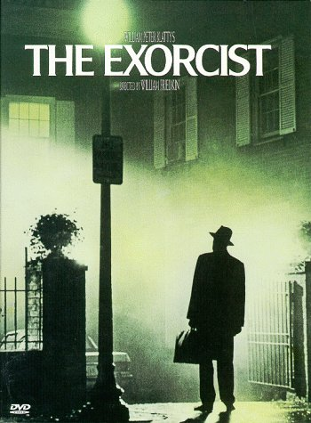
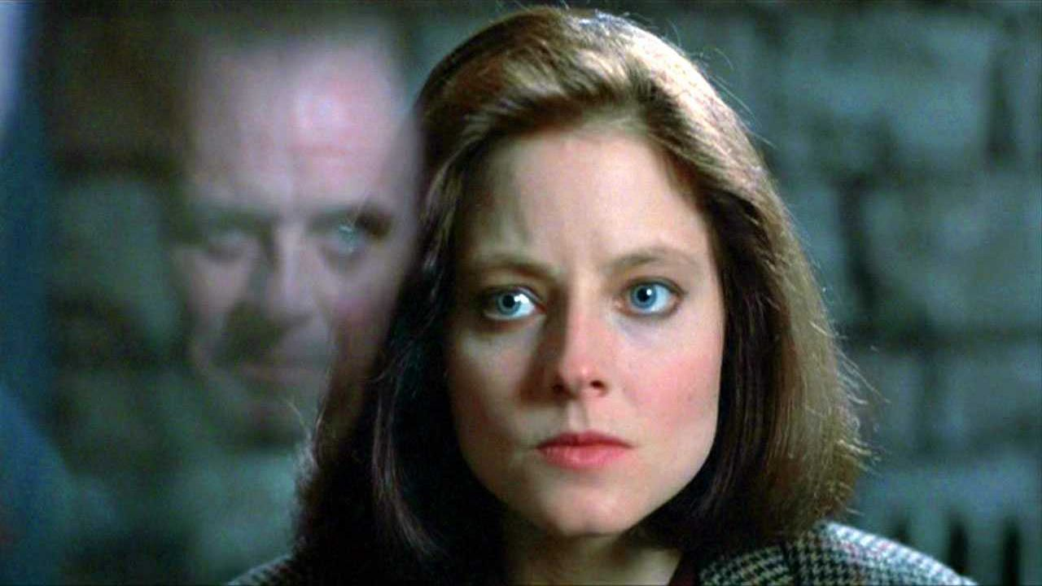
playing on the audience's hidden fears, viewer's nightmares and terror of the unknown.
Include: ghosts, vampires, werewolves, demons, monsters, cannibals and serial killers.

Slide 48
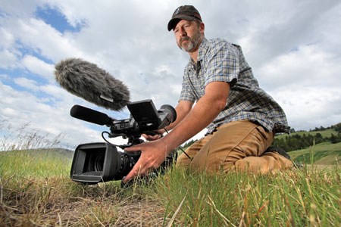
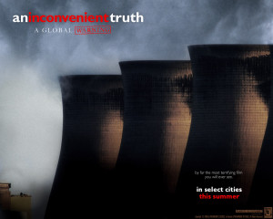
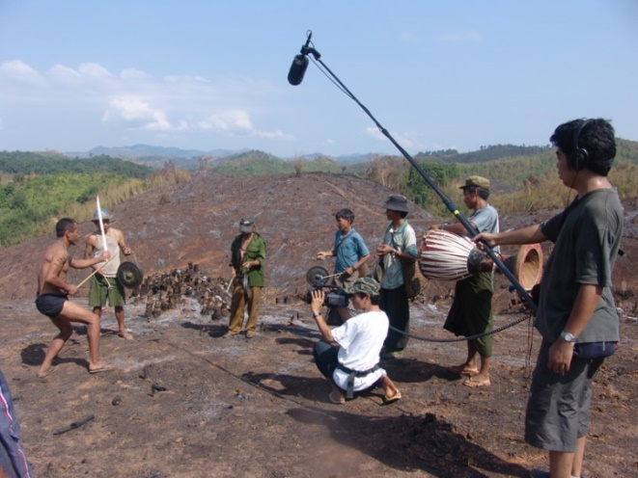
a film or a radio or television programme giving facts about something

Slide 49
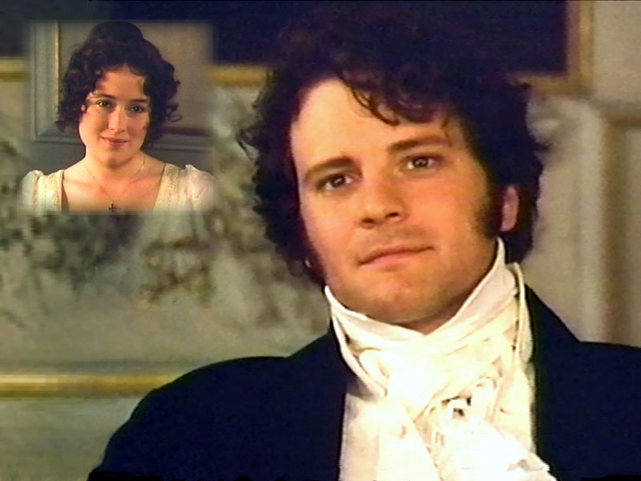
h_ _ _ _ _ _ cal drama / costume drama
about people in the past…

Slide 50
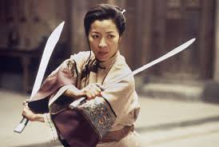
Martial arts movie

Slide 51
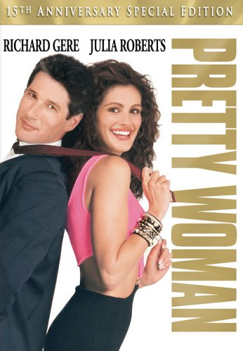

Love stories that are also funny…

Slide 52
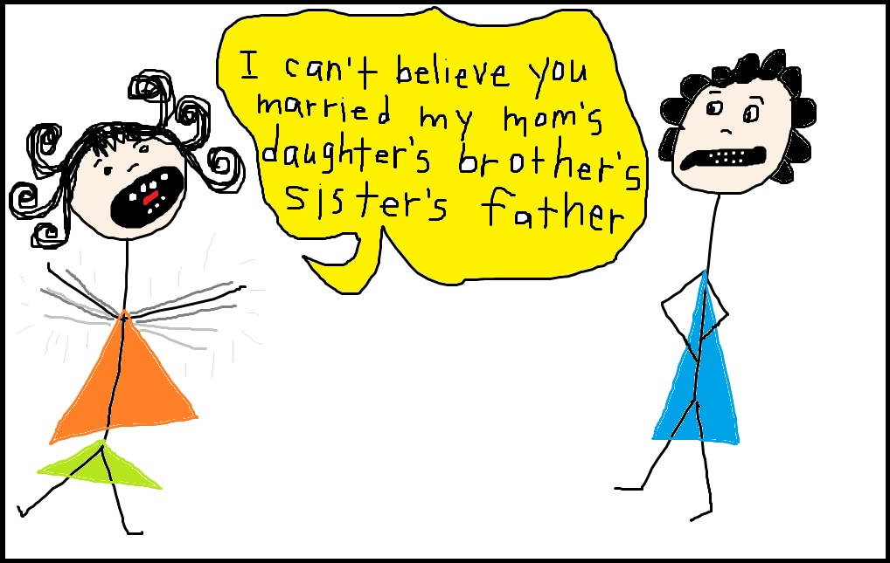
_ _ _ _ - opera
a story about the lives and problems of a group of people which is broadcast every day

Slide 53
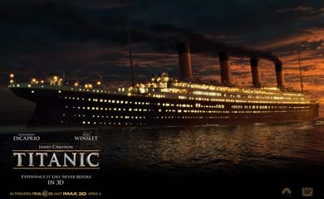
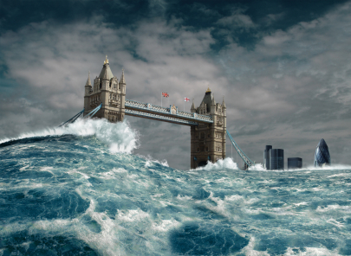
dis_ _ _ _ _ film
Include earthquakes, asteroid collisions, accidents such as shipwrecks or airplane crashes,
or calamities like worldwide disease pandemics.

Slide 54

_ _ _com
a live audience
a studio laugh track
Characters are sharing the same home or workplace …

Slide 55

with lots of singing and dancing

Slide 56


often about aliens from space, the future and space travel…

Slide 57

made using animation techniques…

Slide 58

animated fairy tale

Slide 59


animated cartoon

Slide 60

Chick-flick
Cheerleading
Girls fight over one guy
Unpopular vs popular
Social conflicts

Slide 61


Slide 62

Wordsearch –
How Many Film Genres?

Slide 63
Adjectives to describe films
Good review
Bad review
I find thrillers exciting.

Slide 64
Use modifiers
Not very
Rather
Quite
A bit
Really
Incredibly

Slide 65
the overall feel of a film
STYLE:
magical,
action-packed,
old-fashioned,
futuristic..
unoriginal
inspiring
amusing
award-winning

Slide 66
spoiler (noun, slang)
any element of any summary or description
of any piece of that reveals any plot element
which will give away the ending (avoid these!)

Slide 67

en _ _ _ _ _ _ _ ing
amusing and interesting…

Slide 68

entertain / entertaining /entertained

Slide 69


d_ _ _

Slide 70


dark and depressing

Slide 71

p _ _ _ _ _ _able
you can guess / predict it.

Slide 72


gr _ _ _ _ _ _
I was on the edge of my seat the whole time.

Slide 73


slow- m _ _ _ _ _

Slide 74

ser _ _ u s
It makes you think
thought-provoking

Slide 75

m _ _ _ _ _ / t _ _ _ _ _ _ _

Slide 76

a film with a soppy ending
silly and sentimental; full of unnecessary emotion
soppy love songs
She is soppy about cats.

Slide 77
A film with a puzzling ending
Moving , Surprising, puzzling
SETTING
Familiar
Rural
Urban
Futurustic
Unusual
PLOT : pomplex, fast-moving, believable, gripping
CHARACTERS: likable, convincing, two-dimensional
DIALOGUES: colloquial, realistic, funny
Notes:
f

Slide 78

brutal, bloody , v_ _ _ _ _ t

Slide 79



sp _ _ _ _ _ _ _ _ _

Slide 80

suspence_ _ _
keeps you wanting to know what will happen next

Slide 81


f_ _ - fetched
difficult to believe because it is very unlikely

Slide 82

too poor, tedious, or disturbing to be viewed

Slide 83
Avatar ... WOW! Go and see it! Then go and see it again! Beautiful pictures. Something for everyone in your family! What entertainment!
…………………………………………………………..
Avatar cost a lot of money to make. It is very long.
Technically brilliant, it tries to do too much. The
characters are weak. The story is copied from Dances with
Wolves. Don’t bother!

Slide 84
What types of films do you like or dislike?
That’s interesting
Really?
Cool!
No way!
Me too! Me neither.
Wow!
Do you? Are you?
What types of films are you into?
What else do you like watching?
What do you think of Titanic? (1F)

Slide 85
like or dislike?
I (really/quite/absolutely) like / hate / can’t stand / prefer….
I (don’t) like … very much
I don’t really care for …
… are OK
I’m fond of …
I’m keen on …
I’m interested in …
I’m (not) really into …
I’m a big fan of … / I’m not a big fan of …

Slide 86
Suggesting a night out
John:
Do you want to go out somewhere tonight?
Would you like …
Fiona:
A) Oh there’s no one I want to see at the moment.
B) Yeah OK, I’ll have a look and see what’s on.
C) Oh, I don’t know, what were you thinking of?
D) Thanks but I’ve just eaten.

Slide 87
What do you think of the film?
Did you like it?
Not really, it was too … / it was a bit ….
I loved that movie. / I really enjoyed it.
The plot was great, and the acting was incredible.
I wouldn't be surprised if it were nominated for
an Academy Award.

Slide 88
It’s on
It’s on at Helios cinema.
It’s based on the novel by Robert Ludlum.
It came out about a year ago.
What did you think of it? ~~I really enjoyed it.
What is it about?
Who’s in it?
Danny DeVito plays a detective.
The script is a bit wooden.
The acting is awful.

Slide 89
It it set in… / It stars…
The film is about 2 women who fall in love with the same guy.
It is set in the early 20th century.
Anna and the King is set in Thailand.
It stars Leorado Di Caprio.
Leonardo Di Caprio plays Jack.

Slide 90
a clapper board
a film reel

Slide 91
Titanic gap-fill
Titanic was __________ by James Cameron and is one of the most ________ films ever made, at least, in commercial terms, and has grossed more than one billion dollars for its makers.
It ______ Leonardo DiCaprio and Kate Winslet with Gloria Stuart and Billy Zane in supporting ______. It was the film that made DiCaprio famous.
It is _______ aboard the ill-fated liner Titanic than sank on 14 April, 1912 after hitting an iceberg in the north Atlantic. It is not, however, a true-to-____ account of the disaster, focusing instead, on an on-board romance between two entirely fictional __________ .
DiCaprio _____ Jack, a young artist, leaving England for a better life in the United States. He is poor and travelling in the cheapest part of the ship. Rose, ___________ by Kate Winslet, is a rich young woman engaged to be married and travelling in the luxury of a first class cabin.
awards | box-office | successful | characters | Visual | Costume
critics | set | directed | released | Director | life
Musical | played | stars | roles | plays

Slide 92
They meet by chance and are immediately attracted to each other. Jack is handsome, lively, and above all, good fun. By contrast, Cal Hockley, the wealthy man that Rose is engaged to, is pompous and arrogant. Rose and Jack quickly fall in love after Jack saves Rose’s life when she nearly falls over the side of the ship.
The film was a huge _____ -________ success when it was _________ in 1997, although some _________ were less enthusiastic, seeing the movie as over-sentimental. Nonetheless, it managed to win no less than 11 Academy ________ including those for Best _________, Best _________ Score , Best __________ Effects and Best _________ Design.
awards | box-office | successful | characters | Visual | Costume
critics | set | directed | released | Director | life
Musical | played | stars | roles | plays

Slide 93
Titanic was directed by James Cameron and is one of the most successful films ever made, at least, in commercial terms, and has grossed more than one billion dollars for its makers.
It stars Leonardo DiCaprio and Kate Winslet with Gloria Stuart and Billy Zane in supporting roles. It was the film that made DiCaprio famous.
It is set aboard the ill-fated liner Titanic than sank on 14 April, 1912 after hitting an iceberg in the north Atlantic. It is not, however, a true-to-life account of the disaster, focusing instead, on an on-board romance between two entirely fictional characters.
DiCaprio plays Jack, a young artist, leaving England for a better life in the United States. He is poor and travelling in the cheapest part of the ship. Rose, played by Kate Winslet, is a rich young woman engaged to be married and travelling in the luxury of a first class cabin.

Slide 94
They meet by chance and are immediately attracted to each other. Jack is handsome, lively, and above all, good fun. By contrast, Cal Hockley, the wealthy man that Rose is engaged to, is pompous and arrogant. Rose and Jack quickly fall in love after Jack saves Rose’s life when she nearly falls over the side of the ship.
The film was a huge box-office success when it was released in 1997, although some critics were less enthusiastic, seeing the movie as over-sentimental. Nonetheless, it managed to win no less than 11 Academy awards including those for Best Director, Best Musical Score , Best Visual Effects and Best Costume Design.

Slide 95
Film- vocab revision
Harry Potter and the Philosopher's Stone, (1) ____________ in 2001. It is an adventure film and(2) ____________on the novel by J K Rowling. The main (3)_____________, Harry Potter, (4)____________by Daniel Radcliffe. Harry is an 11 year old boy who discovers he has magical powers.
The film (5)_____________by Chris Columbus and (6) ___________in an imaginary school for wizards called Hogwart's. The (7) ____________ includes a number of well-known British actors and actresses such as John Cleese, Robbie Coltrane and Richard Harris.
The film earned over US$976 million at the (8) _____________and received generally positive reviews from the critics. It _____________ on DVD
box office | has been released | character
is set | was made | is played
was directed | is based | cast

Slide 96

MAINSTREAM FILMS usual, or commonly done high-budget, popular, and made for entertainment
ALTERNATIVE FILMS

Slide 97

I go to the theatre to see a p…
Theatre

Slide 98


a play
a performance

Slide 99

a performance of a play

Slide 100


Slide 101

A_ _ _ _ _ _ e
people watching a film or performance

Slide 102
prefer … to …
I prefer watching DVDs at home to going to the cinema

Slide 103
Film Vocabulary 2
Filmmaking

Slide 104

–ed and –ing adjectives

Slide 105


S_ _ _ _ _ or computer generated imaging?
S_ _ _ _men perform the s_ _ _ _ _

Slide 106

_ _ _ _ _ _ film

Slide 107


slow - _ _ _ _ _ _
an effect in film-making
whereby time appears
to be slowed down.

Slide 108

film i_ _ _ _ _ _ _

Slide 109

on l_ _ _ _ _ _ _
It was made on location in Africa

Slide 110

film _ _ _ _ _ _

Slide 111


fight s_ _ _ _ _

Slide 112
Plot
the story, what happens in the film:
unpredictable / predictable,
original,
full of twists,
realistic / unrealistic,
complicated
Notes:
Original, full of twist

Slide 113


Twist

Slide 114
Sound track
recorded dialogues, music, narration and sound effects

Slide 115
Screenplay
a script written to be produced as a movie.

Slide 116

Characters
The people who the film is about:
funny, nice , happy, miserable, cute

Slide 117


HERO or VILLAIN
VILLAIN :
an "evil" character in a story
“baddie”, bad guy

Slide 118

Dialogue
witty,
amusing,
fast-paced,
slow-paced,
smart,
offensive,
confusing,
obvious...

Slide 119

Scenery
Scenery is what is the background of a film - this could be the furniture in a room or the surrounding landscape:
beautiful, ugly, spectacular, cinematic, city, country, recognisable, foreign, fantastical, colourful

Slide 120
A great box-office success
Harry Potter films have been a great box-office success

Slide 121

The Oscars Award Ceremony
The winner is …

Slide 122

Exercise 1

Slide 123

Exercise 2

Slide 124


Gratitude and tears
I’m grateful for… accept the Oscar and make a speech

Slide 125


Dress to impress

Slide 126

Are there any tickets?
COMMUNICATION

Slide 127




Slide 128


At the box office

Slide 129

Complete the dialogue

Slide 130
Good evening. How can I help you?
I’d like to book 3 tickets for Eclipse, please.
Which showing?
Pardon?
Which showing would you like?
The seven thirty, please.
I’m afraid that showing is sold out.
What about the 10:30 showing?
Yes, we have tickets for that. Children or adults?
Two 17-year-olds.
Ok, that’s two adults. That will be Ł15.
OK. Here you are.
Thanks. And Ł5 change.

Slide 131
Good evening. How can I help you?
I’d like to book 3 tickets for Eclipse, please.
Which showing?
Pardo ?
Which showing would you like?
The seven thirty, please.
I’m afraid that showing is sold out.
What about the 10:30 showing ?
Yes, we have tickets for that. Children or adults?
Two 17-year-olds.
Ok, that’s two adults. That will be Ł15.
OK. Here you are.
Thanks. And Ł5 change.

Slide 132
Good evening. How can I help you?
I’d like to book 3 tickets for Eclipse, please.
Which showing?
Pardo ?
Which showing would you like?
The seven thirty, please.
I’m afraid that showing is sold out.
What about the 10:30 showing ?
Yes, we have tickets for that. Children or adults?
Two 17-year-olds.
Ok, that’s two adults. That will be Ł15.
OK. Here yo are.
Thanks. And Ł5 change.

Slide 133
Good evening. How can I help you?
I’d like t book 3 tickets for Eclipse, please.
Which showing?
Pardo ?
Which showing would you like?
The seven thirty, please.
I’m afraid that showing is sold out.
hat bout the 10:30 showin ?
Yes, we have tickets for that. Children or adults?
Two 17-year-olds.
Ok, that’s two adults. That will be Ł15.
OK. Here you ar.
Thanks. And Ł5 change.

Slide 134
Good evening. How can I help you?
I’d like t book 3 tickets for Eclipse, leas .
Which showing?
Pardo ?
Which showing would you like?
Th seven thirty, please.
I’m afraid that showing is sold out.
Wha bout the 10:30 showin ?
Yes, we have tickets for that. Children or adults?
Two 17-year-old s.
Ok, that’s two adults. That will be Ł15.
OK. Here you ar.
Thanks. And Ł5 change.

Slide 135
Good evening. How can I help you?
I’d lik t book 3 tickets for Eclipse, leas .
Which showing?
Pardo ?
Which showing would you like?
Th seven thirty, please.
I’m afraid that showing is sold out.
Wha bout the 10:30 showin ?
Yes, we have tickets for that. Children or adults?
Two 17-year-old s.
Ok, that’s two adults. That will be Ł15.
OK. Here you ar.
Thanks. And Ł5 change.

Slide 136
Good evening. How can I help you?
I’d like t book 3 tickets for leas .
Which showing?
Pardo ?
Which showing would you like?
Th seven thirt lease.
I’m afraid that showing is sold out.
Wha bout the 10:30 showin ?
Yes, we have tickets for that. Children or adults?
Two 17-year-old s.
Ok, that’s two adults. That will be Ł15.
OK. Here you ar.
Thanks. And Ł5 change.

Slide 137
Good evening. How can I help you?
I’d like t book 3 ticket for Eclipse, leas .
Which showing?
Pardo ?
Which showing would you like?
he seven thirt lease.
I’m afraid that showing is sold out.
Wha bout the 10:30 showin ?
Yes, we have tickets for that. Children or adults?
Two 17-year-old s..
Ok, that’s two adults. That will be Ł15.
OK. Here you ar.
Thanks. And Ł5 change.

Slide 138
Good evening. How can I help you?
I’d like t book 3 tickets for Ecl , leas ..
Which showing?
Pardo ?
Which showing would you like?
The seven t thirty, please.
I’m afraid that showing is sold out.
Wha bout the showin ?
Yes, we have tickets for that. Children or adults?
wo 17-year-old s..
Ok, that’s two adults. That will be Ł15.
OK. Here you ar. .
Thanks. And Ł5 change.

Slide 139
Good evening. How can I help you?
I’d t book tickets for Ecli leas ...
Which showing?
Pardo ?
Which showing would you like?
ven
I’m afraid that showing is sold out.
Wha bout the 0 showin ?
Yes, we have tickets for that. Children or adults?
wo 17-year old s..
Ok, that’s two adults. That will be Ł15.
OK. Here you ar. .
Thanks. And Ł5 change.

Slide 140


Slide 141


Slide 142


Slide 143


Slide 144
Popcorn Movie Seat
I went to a 1:30pm movie. First screening of the day in that theatre. Bought the popcorn and was first into the room. I had every seat to choose from. Great! I went for middle-middle. Yeah. Best seat in the house.
As I went to sit down, my purse slipped off my shoulder and landed heavily on my forearm. The impact triggered the reflex that makes the bicep instantly contract to prevent the purse from landing on the floor. But today, the hand was holding a full bag of popcorn.
Wow, what a shower of popcorn that was. At least half the bag was liberated in that split second and distributed strangely evenly in the nine seats around me. White popcorn. Dark room. Dark seats. Only if the popcorn were glowing or on fire might my faux pas be more obvious.
Sure I could move to another seat, but to whoever came into the theatre next it would be eminently obvious that it was me who had done the redecorating. So I smiled at the incident, brushed my head, shoulders and seat clear, and then sat down amid the mess and ate the remainder of the popcorn in the bag while I watched the movie – okay, the remainder of the popcorn didn’t even last through the trailers. And perhaps not so predictably, no one sat in the eight popcorn seats around me… though I don’t recommend using this story as a strategy of saving extras seats in a movie theatre.

Slide 145

New Technology Quiz

Slide 146


