Slide 1


JUROR
While serving as a juror in a high profile murder trial, family man Justin Kemp finds himself struggling with a serious moral dilemma…one he could use to sway the jury verdict and potentially convict—or free—the accused killer.

Slide 2
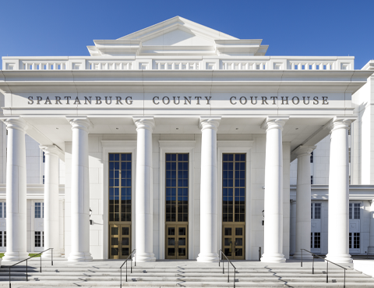
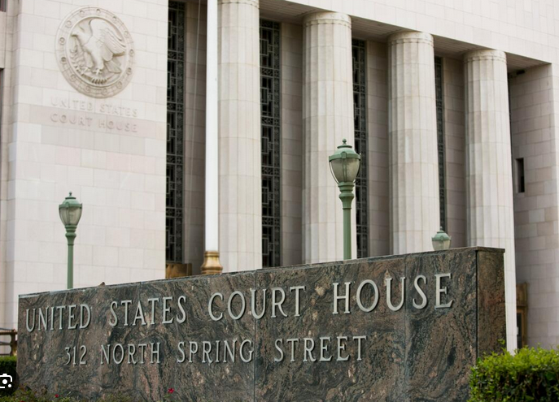
Courthouse

Slide 3
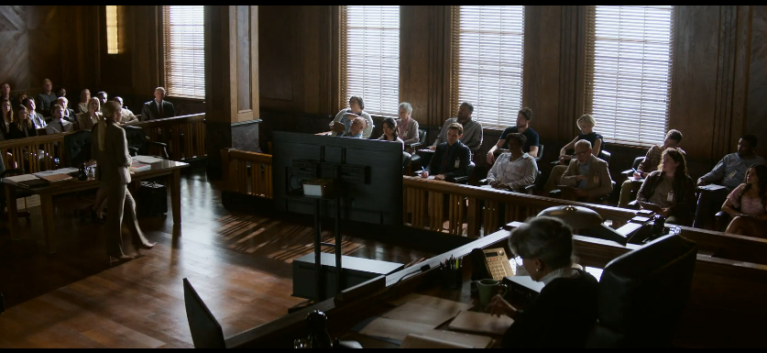

Slide 4
the enclosed space in which courts of law are held in front of a judge.
COURTROOM

Slide 5
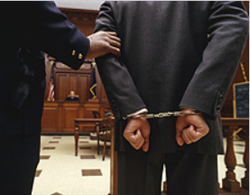

Slide 6
a person in a court of law who is accused of having done something wrong
DEFENDANT

Slide 7
https://ww7.watchseriesfree.co/movie/juror-2-1630857882/

Slide 8
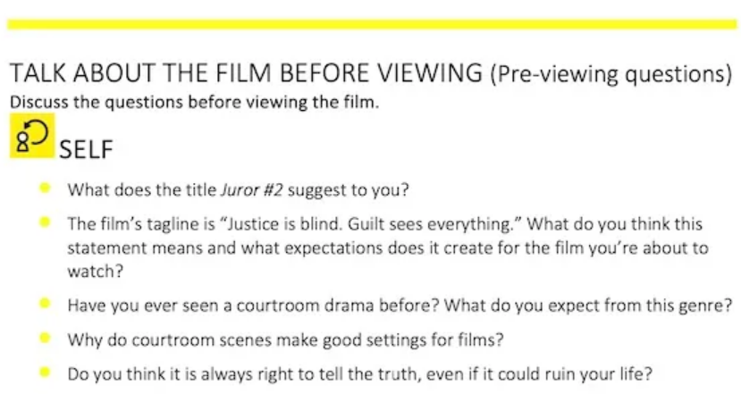

Slide 9
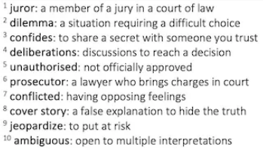

Slide 10
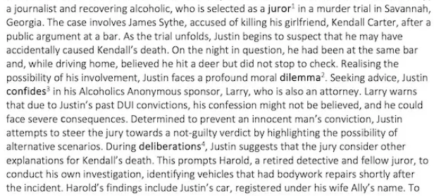

Slide 11
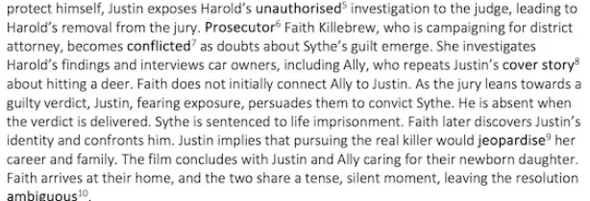

Slide 12


Slide 13
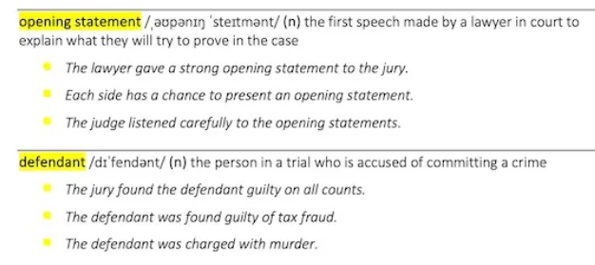

Slide 14
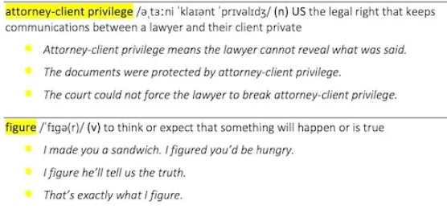

Slide 15


Slide 16
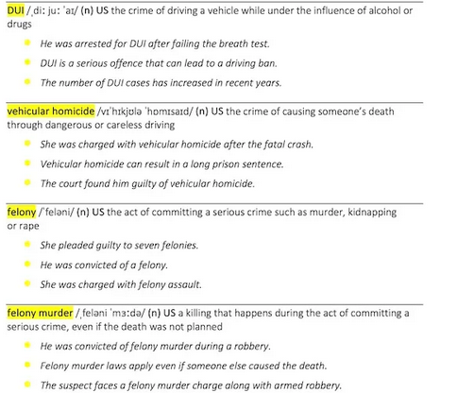

Slide 17
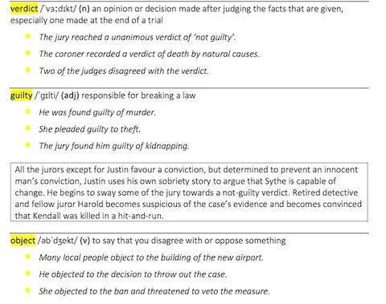

Slide 18



Slide 19
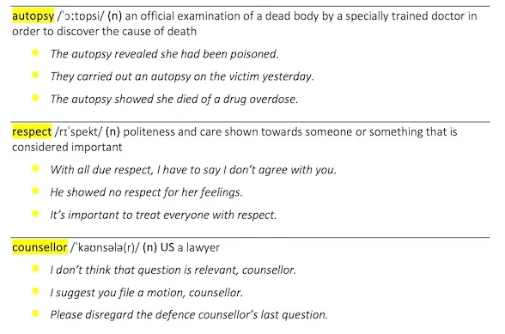

Slide 20


Slide 21
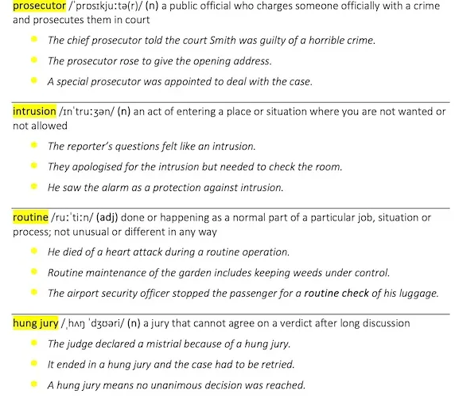

Slide 22


Slide 23


Slide 24


Slide 25


Slide 26


Slide 27


Slide 29
After viewing

Slide 30
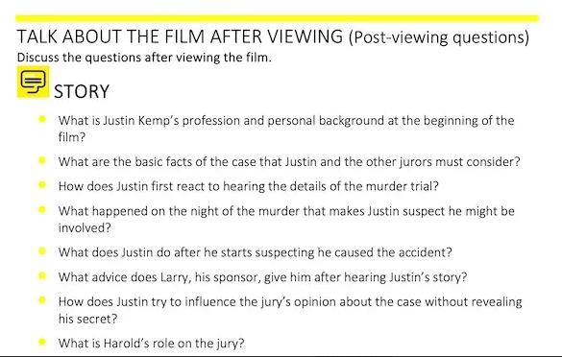

Slide 31
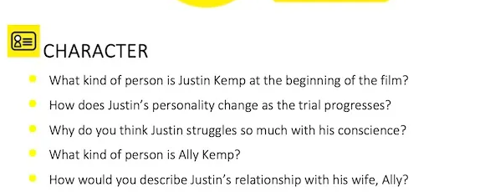

Slide 32
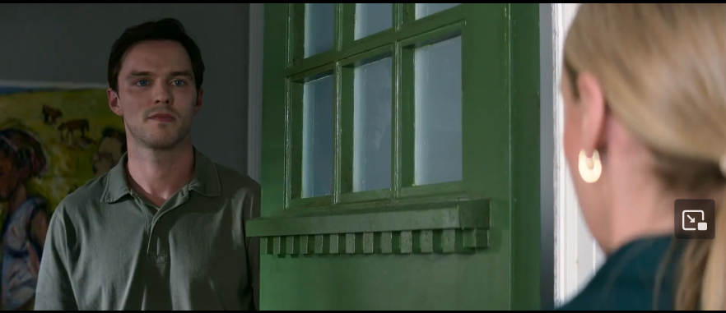

Slide 33
