Slide 1
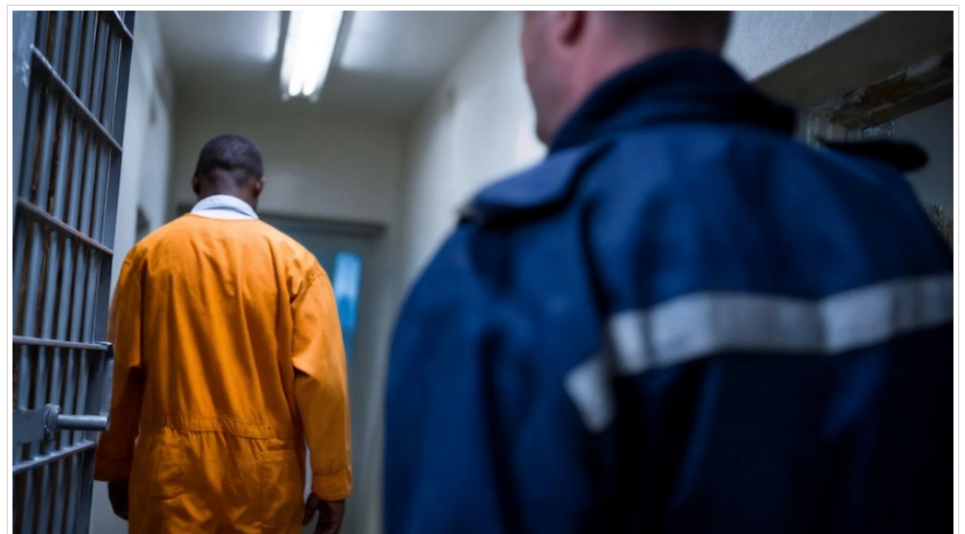

Slide 2
Life inside a PRison

Slide 3
Topics:
Prisons, their role in society and the realities of working in a prison environment

Slide 4
Objectives:
To introduce students to the theme of prisons and their role in society.
To introduce students to the realities of working in a prison environment.
To expand students’ vocabulary related to prisons, institutional work and trauma.
To develop their viewing listening and reading comprehension skills.
To develop writing skills through reflective & creative tasks using new vocab.
To improve students’ speaking skills through discussion and roleplay using topic-specific language.
To improve students’ visual representing skills through multimodal composition homework tasks.
To practise critical thinking through analysis reflection and ethical discussion.

Slide 5
Students
learn vocabulary related to prisons, institutional work and trauma,
discuss quotations about prisons, talk about institutional work,
predict the content of a short video,
watch a short video,
answer comprehension questions,
analyse a short video,
write about what they have learned from viewing a short video,
develop critical thinking skills by exploring issues raised in a short video,
perform a roleplay,
read an article „Invisible Jobs: Why Society Overlooks Prison Staff,
answer comprehension questions,
discuss topics raised in an article,
write about what they have learned from reading an article,
and reflect on the lesson.

Slide 6
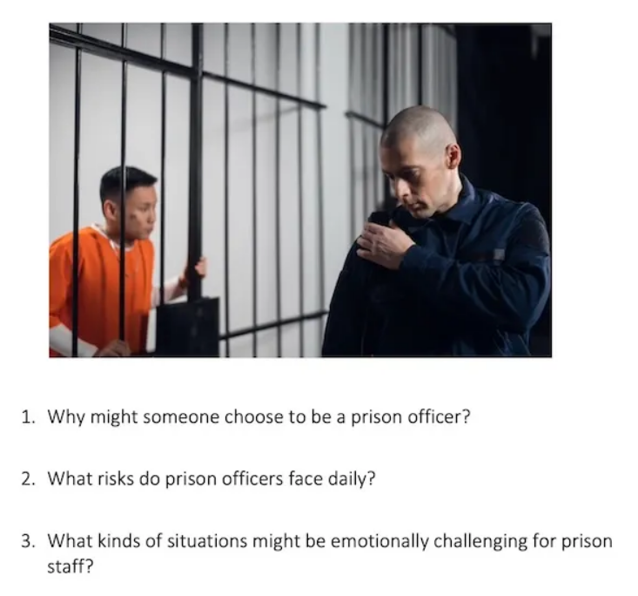

Slide 7
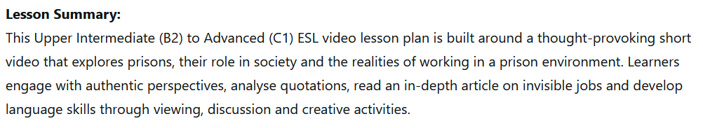
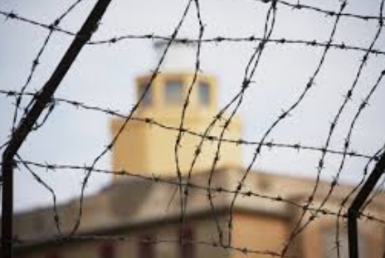

Slide 8
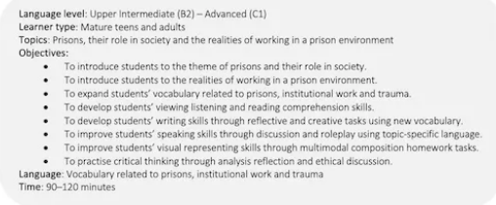

Slide 9
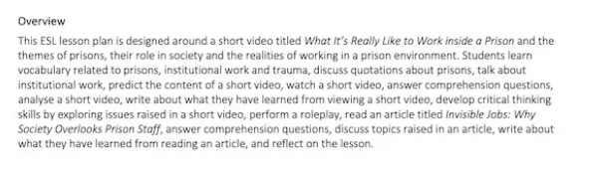

Slide 10
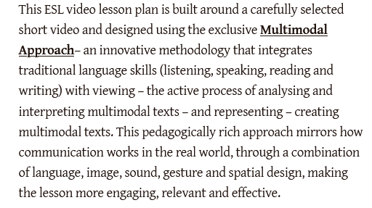

Slide 11
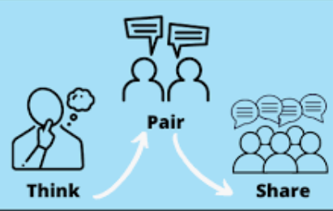
What words do you associate with prisons?
1. Read the question carefully, make notes.
2. Compare and discuss in pairs.
3. Feedback from the whole class.

Slide 12


Slide 13


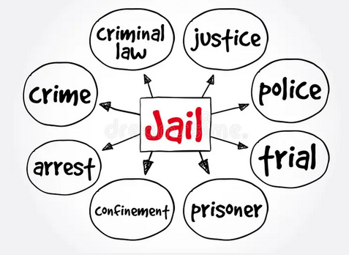






Slide 14






Look at the quatation, consider the meaning and make some notes.

Slide 15
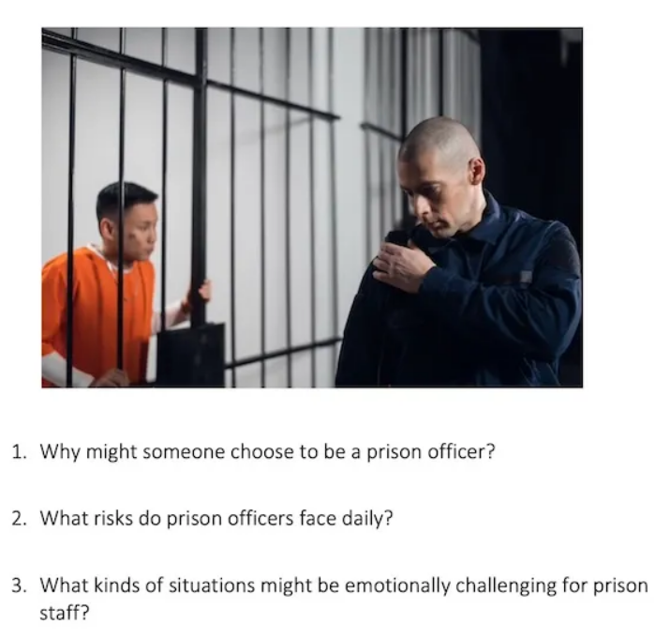

Slide 16

https://www.youtube.com/watch?v=r_FxfYZcC_8

Slide 17
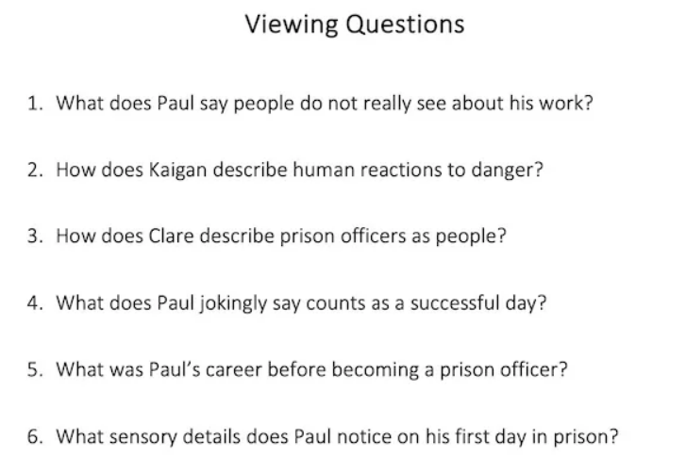

Slide 18
https://www.youtube.com/watch?v=r_FxfYZcC_8

Slide 19
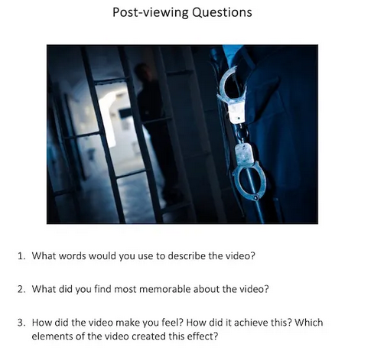

Slide 20
Bolt out of the blue
Sympathy & concern for others
Emotionally connected
assault
bonded
Requiring a great effort
Action-orientated
To recover emotionally
compassion
environment
unexpected
Dust yourself off
Attack violently
demanding
The conditions in which people work and live
Focused on taking action

Slide 21
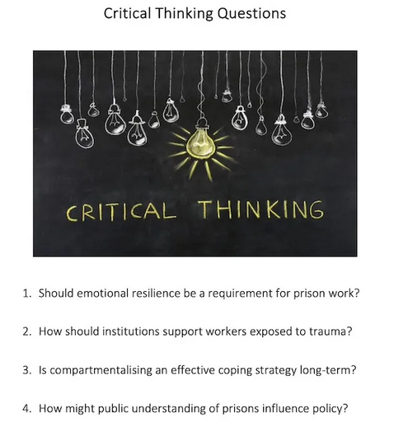

Slide 22


Slide 23
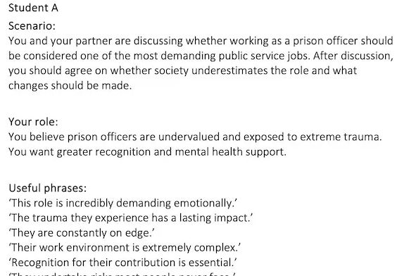
They undertake risks most people never face.

Slide 24
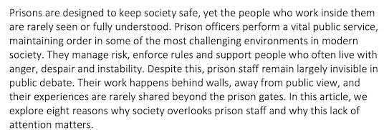


Slide 25
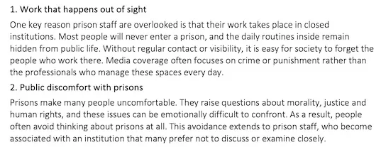

Slide 26
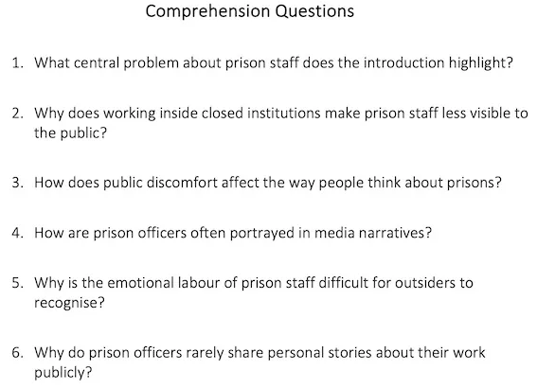

Slide 27
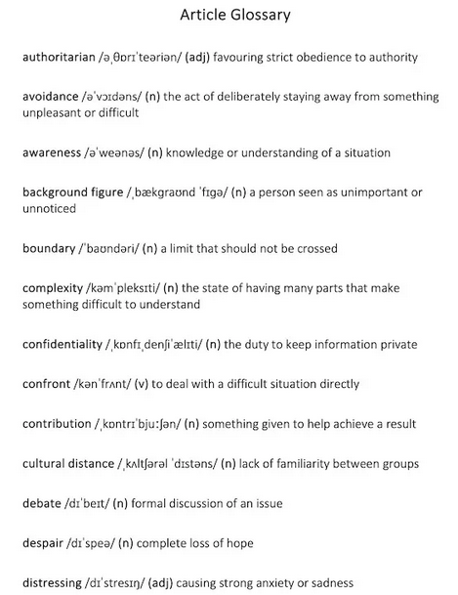

Slide 28
