Slide 1

Videotelling
Mister Winner

Slide 2
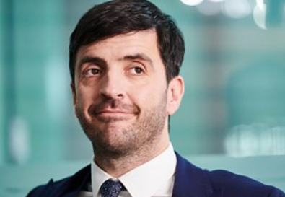
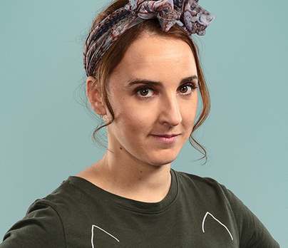
What can you tell about those two?
Leslie
Gem(ma)

Slide 3
They are about to …
Leslie
Gem(ma)

Slide 4
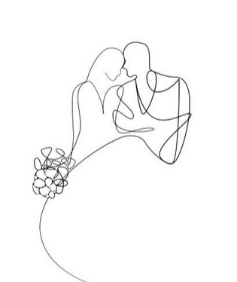
The wedding
They are engaged.
the newlyweds-to-be
They are about to get married.
TASK:
1. Draw the wedding scenery (2 minutes)
Don’t create a detailed masterpiece.
2. Describe the scene.
Who:
Bride & Groom, flower girl, Maid of honour, braidsmaids, Best man, guests

Slide 5
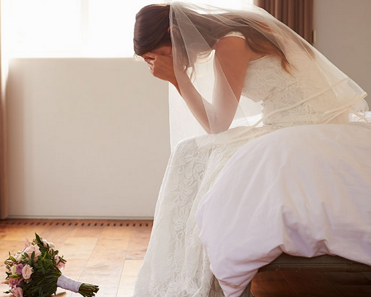
The wedding day. What could possibly go wrong?
https://drive.google.com/file/d/1CQjQRHVk5-U9nasQqDINo8KxW5eEEJHA/view
https://www.facebook.com/watch/?v=2378608592271448
Why is he having second thoughts?
Words used for hypothesizing:
probably,
perhaps,
I suppose,
may, might, could.

Slide 6
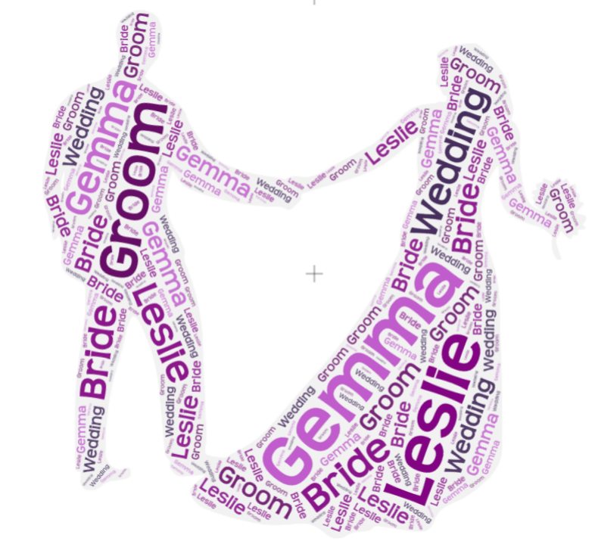
Describe what happened
(one student-one sentence
Leslie and Gem are …
They are about to….
Everything is ….
A few hours before the wedding he tells her….
The reason is because….
Gem tries to …
Gem feels …
She is afraid they will have to …..
When the guests found out about Leslie's finger they …
CAN THE WEDDING BE SAVED?

Slide 7
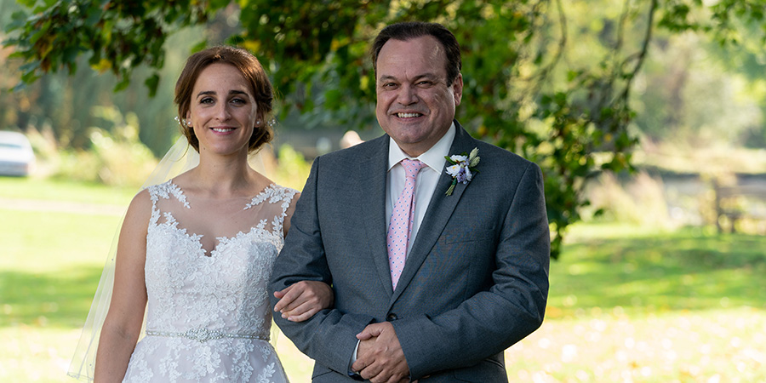
When there is drama there’s a saviour
the one and only
father of the Bride
https://drive.google.com/file/d/1CQjQRHVk5-U9nasQqDINo8KxW5eEEJHA/view?usp=sharing
How did he save the wedding? Watch 1.50 up to 2:06

Slide 8
ALL'S WELL THAT ENDS WELL
https://drive.google.com/file/d/1CQjQRHVk5-U9nasQqDINo8KxW5eEEJHA/view?usp=sharing
TASK
In pairs: retell the whole story.
Give advice for Laslie to get his finger out from the wall.

Slide 9
Thanks for watching & leave the feedback!

